Slide 1


Application of Graph Theory in Cryptography
NITK, Surathkal
2020-2021
Team Members:
Aprameya Dash - 191IT109
Maheshwari Mihir Premjibhai-191IT129
Suyash Chintawar - 191IT109
Kunal Singh Lohiya -191IT128
Course Title : Discrete Mathematics (IT203)
Course Instructor: Mr. Dinesh Naik,
Mr. Manjunath K Vanahalli

Slide 2
Cryptography
Cryptography refers to secure information and communication techniques derived from mathematical concepts and a set of rule-based calculations called algorithms, to transform messages in ways that are hard to decipher.
These deterministic algorithms are used for cryptographic key generation, digital signing, verification to protect data privacy, web browsing on the internet, and confidential communications such as credit card transactions and email.
In this paper, Graph Theory is being used to create a secure Encryption - Decryption algorithm. For encrypting the data, we will use graphs to store the data of the input message. The concepts of Graph theory used in our algorithm are shown in the next slide.

Slide 3
Graph Theory
Undirected Graph : An undirected Graph is denoted by G(V, E) where V is the set of vertices and E is a set of edges that connect vertices with each other. Information can be stored in each of the vertices.
Spanning tree : In Graph Theory, a spanning tree T of an undirected graph G is a subgraph that is a tree which includes all of the vertices of G, with a minimum possible number of edges.
A minimum spanning tree is a spanning tree whose sum of edge weights is as small as possible.
Weighted undirected graphs have been used to store, encode and decode the data.
Adjacency Matrix : It is a square matrix used to represent a finite graph . The elements of the matrix indicate whether pairs of vertices are adjacent or not in the graph.

Slide 4
The value of the matrix element in the adjacency matrix is the number of edges between those two vertices.
Prim’s Algorithm : MST can be computed using this algorithm. It can be implemented using heaps as well as adjacency matrices. In this project, we have used the matrix implementation of Prim’s Algorithm.
The idea behind Prim’s algorithm is simple, as discussed, a spanning tree means all vertices must be connected. So the two disjoint subsets of vertices(one contains the vertices already included in MST and other contains rest of the vertices) must be connected to make a Spanning Tree. And they must be connected with the minimum weight edge to make it a Minimum Spanning Tree.

Slide 5
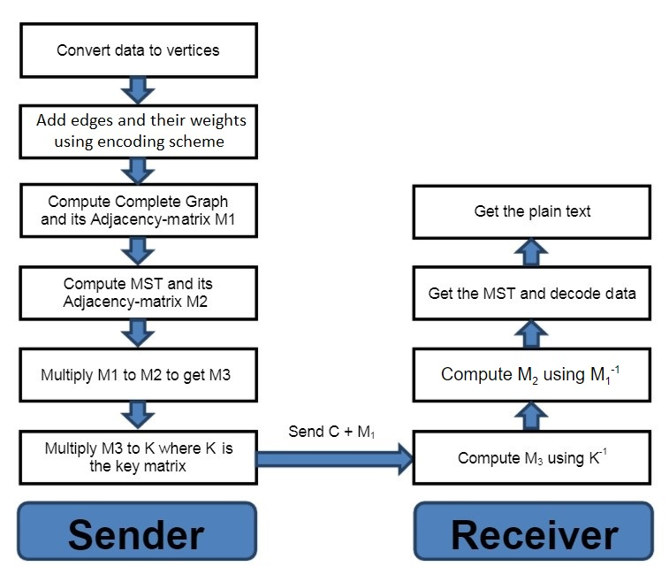

Slide 6
Scheme to assign weights to edges
Start with the character that has been used to point to the 1st character of the input string (‘A’ in our case). Calculate the difference between the ASCII values of the 1st character of the input string and this pointer character and assign this weight to the edge between these two vertices by adding one.
If the edge is a side of the polygon(cycle) or between the special character and the starting character, then for computing the edge weights, ASCII values of the characters are considered and the edge weight of any such edge is computed by calculating the difference between the ASCII values of the characters and then adding one to it. Calculate this difference for each edge in a cyclic manner.
The reason for adding one in the above method is to avoid the edge weight of two same characters from becoming zero. And if the edge weight becomes zero, then while computing the MST the program will consider that no edge lies between these vertices which is a wrong assumption.
If the edge is a diagonal of the polygon, then edge weights are sequentially assigned starting from 256 and increasing the weight by 1 each time.

Slide 7
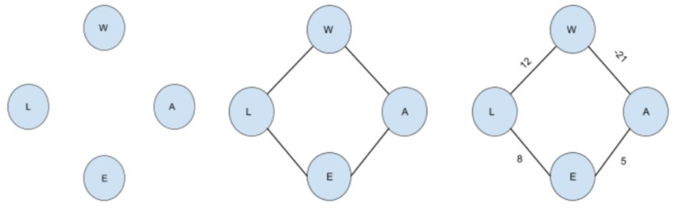
Encoding Process
Step 1: Converting characters of the message to vertices of graph
Step 2: Adding edges to form a complete cycle of the input
Step 3: Add weights to each of the edges of the cycle
Step1
Step2
Step3

Slide 8
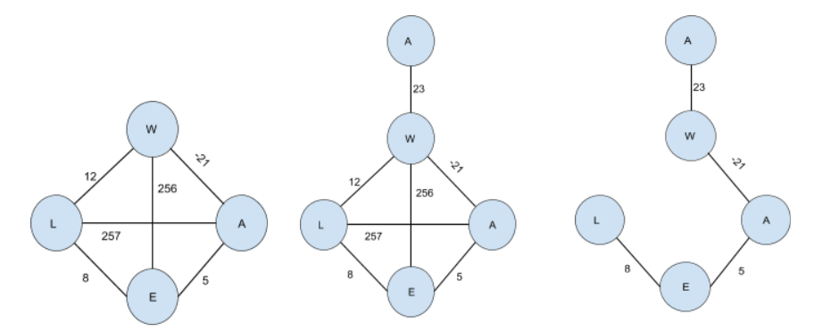
Step 4: Add weights to the diagonals to create a complete graph
Step 5:Add a special character to indicate the starting character
Step 6: Compute MST and its adjacency matrix M2
Step 4
Step 5
Step 6

Slide 9
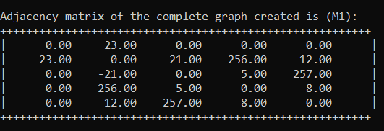
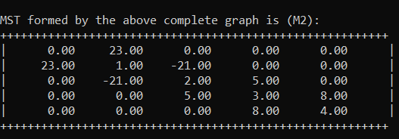
Step 7: Computing Matrix M3
M₃ = M₁ * M₂
Step 8: Computing Cipher Matrix
Cipher = Key * M₃
Send ( Cipher + M₁) to Receiver
Matrix M1
Matrix M2

Slide 10
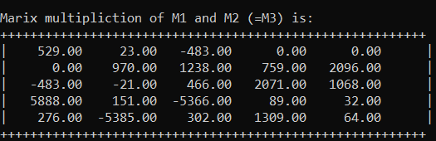
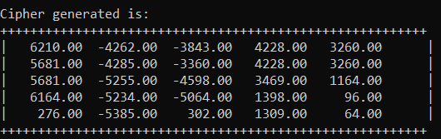
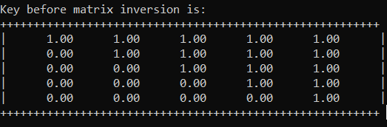
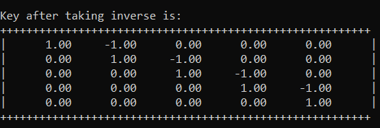
Matrix M3
Cipher Matrix
Shared Key
Key-Inverse

Slide 11
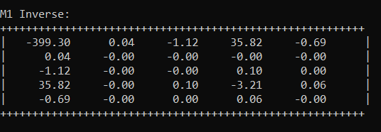
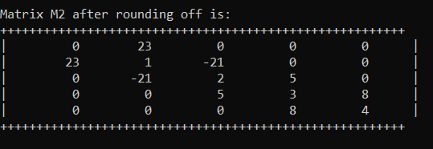
Decoding Process
Step 1: Receive the data, compute inverse of Key
Step 2: Compute M₃ using Key⁻¹ and Cipher
M₃ = Key⁻¹ * Cipher
Step 3: Compute M2 using M1⁻¹ and M3
M₂ = M1⁻¹ * M₃
Step 4: Get the MST and decode data
Matrix M1⁻¹
Matrix M2

Slide 12
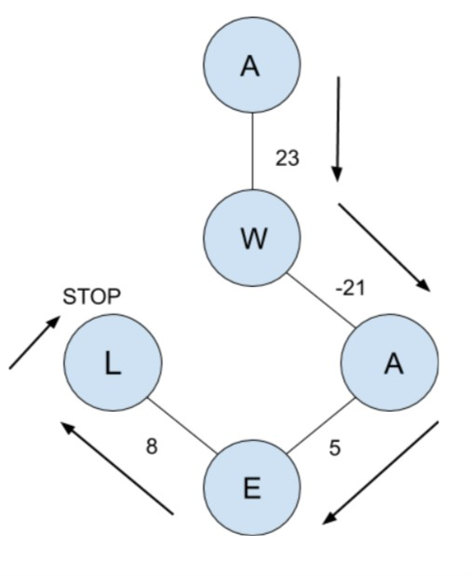
Decryption
Message Decoded:
WAEL

Slide 13
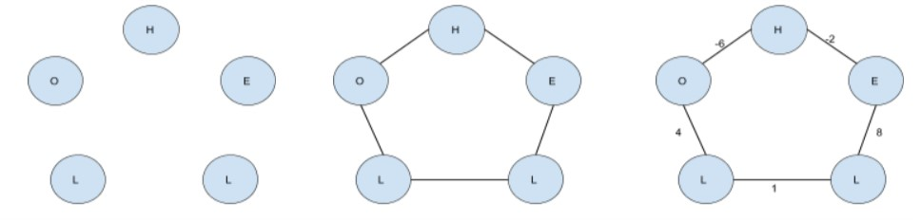
Encryption of “HELLO”
In the previous example the MST formed was a straight chain. But this is not the case always.
Many times, the MST formed may be branched at the vertex of the first character of the message.This can be visualised by using the algorithm for the word “HELLO”.
The steps followed in this case are shown below.
Step 1
Step 2
Step 3

Slide 14
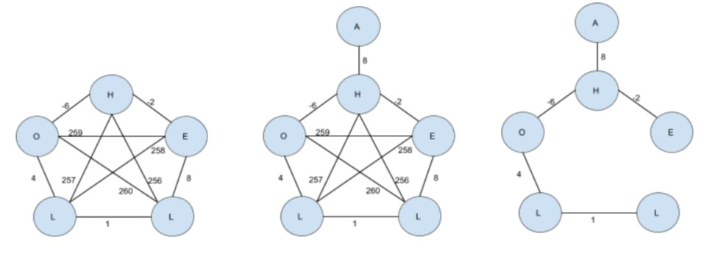
Encryption of “HELLO”
Step 4
Step 5
Step 6

Slide 15
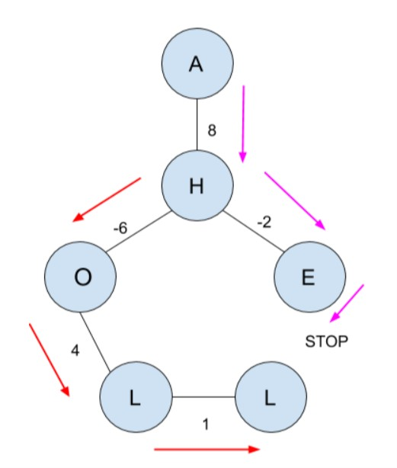
Decryption
Message Decoded in trip 1:
String 1 = “HE”
Message Decoded in trip 2:
String 2 = “OLL
Final Decode message:
String 1 + reverse(String 2)
HELLO

Slide 16
Improvements
For better performance of the algorithm we made some changes in the algorithm of the base paper
The base paper considered only encryption of uppercase characters A-Z. We extended it to encryption of all characters by adjusting the encoding scheme by using ASCII values rather than assigning the order of the A-Z characters as 1-26.
The diagonal weights were assigned sequentially from 256 to avoid the clash of the other ASCII characters.
In some cases, it is possible that the determinant of the matrix M1 can become zero. In these cases, the inverse of M1 cannot be computed. In our algorithm, we throw an error in such circumstances.

Slide 17
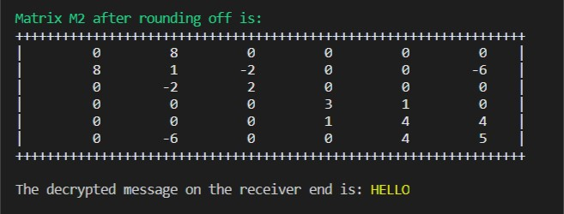
Result and Conclusion
This proposed algorithm was implemented by us using C++ programming language. Our implementation takes the message as input. First the program encodes the input message using the encoding algorithm. Then this encoded message is passed on to the decoding module of our program. The decoding module decodes the message and finally displays the decoded message

Slide 18
References
1. Encryption Algorithm Using Graph Theory. 2014. N.p.: Wael Etaiwi.
https://www.researchgate.net/publication/269803082_Encryption_Algorithm_Using_Graph_Theory.

Slide 19
----*----*----
Thank You!!
----*----*----

